Slide 1
DEVELOPMENT OF ALUMNI MANAGEMENT SYSTEM WITH DATA ANALYTICS, VISUALIZATION, AND PRESCRIPTION MODULE
Capstone project Presented by
James Lenard Soriano & Christ jancinth Robles

Slide 2

Project Context
Alumni Management Systems are essential for providing enduring connections between educational institutions and their graduates, which are recognized as valuable assets contributing to reputation and industry networks.
Alumni involvement is important for schools as they are great resources and can make the schools better, as they have an important role in the educational sector as they are the legacy runners of the institute they used to belong to (Vidyalaya, 2022).
University alumni systems exist to promote active and ongoing relationships between graduates and their alma mater. (Chi, Jones, & Grandham, 2012).
Notes:
Alumni management systems are known to be essential for providing connections between the school and their graduates, which are recognized as valuable assets contributing to reputation and industry.
Furthermore, according to Vidyalaya, alumni involvement is important for schools as they are great resources, also they have an important role as legacy runners of the institute they used to belong to.
According to Chi, Jones, and Grandham, alumni systems exist to promote active and ongoing relationships between graduates and their alma mater.

Slide 3
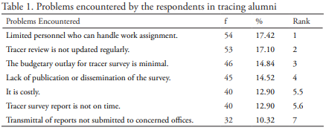
Project Context
Based on Etcuban’s (2015) results in his study, during the development of University of Cebu’s Alumni Database, their respondents encountered multiple problems in tracing alumni.
Limited personnel who are able to handle the work assignment
Outdated tracer review
Minimal budgetary outlay for tracer survey
Lack of survey dissemination or publication
Costly
Untimely tracer survey report
Lack of submitted transmittal reports
Notes:
Now, there are problems persisted in tracing and managing alumni systems. For instance, from Etcuban’s study during the development of the Alumni Database for the University of Cebu, their respondents encountered these set of problems: limited personnel, outdated tracer review, minimal budgetary outlay, and lack of survey dissemination.

Slide 4
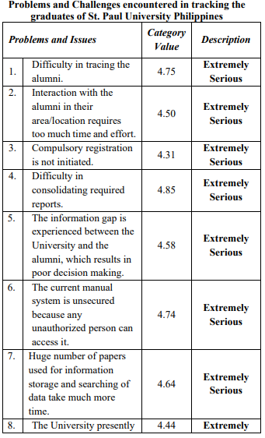
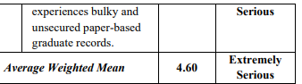
Project Context
In the study written by Capili-Kummer and Corpuz-Batagal (2021), their respondents encountered their own set of problems:
Difficulty in consolidating required reports
Problems in tracing the alumni
Their manual system lacks the security it needed
Huge numbers of papers for information storage and data searching takes more time
Information gap that results in poor decision-making
Interaction with alumni in their area takes too much time and effort
University experiences bulky and unsecured paper-based records
Compulsory registration is not initiated
Notes:
On another study by Capili-Kummer and Corpuz-Batagal, these are the problems encountered tracing the alumni of St. Paul University Philippines: difficulty in consolidating reports, problems in tracing the alumni, and manual system lacks the security it needed.

Slide 5

Project Context
Furthermore, the developers learned that there were past researchers who developed the alumni tracking system (Olea & Trapago, 2015; Buenaobra, Matundan, & Angeles, 2016), which also tried to solve the problems mentioned. Both systems succeed from its testing phase to its launching. However, the current whereabouts of the system hasn’t been turned over according to the client. Also, the developers recently inquired the administrators of the house of alumni of LSPU Los Banos Campus regarding tracing the alumni of College of Computer Studies, they discovered that currently 88% of 197 alumni of the year 2021 responded, then 23.77% of 98 alumni of the year 2022.
Notes:
We also learned that there are already past researchers who developed an alumni tracking system in 2015 and 2016, however there were no turnover with the administrators of the house of alumni thus becoming our clients in this matter. Also the developers recently inquired the administrators regarding the tracing of the alumni of CCS, which in the year 2021, 88% out of 197 alumni responded from the tracer survey, however at the year of 2022, 23.77% out of 98 alumni responded.

Slide 6
Project Context
Some of the aforementioned problems were also experienced based on the issues encountered by the administrators of the house of alumni in Laguna State Polytechnic University in Los Baños Campus. Data quality issues, untraceability of alumni, lack of active connection between and the lack of a sustainable and centralized alumni system.
Notes:
The aforementioned problems from the other universities also encountered by the administrators of the house of alumni of LSPU. Like the data quality issues, untraceability of alumni, lack of active connection between, and lastly, no centralized and sustainable system.

Slide 7

Project Context
Efforts to address these challenges have evolved alongside technological advancements, as integration of data analytics has opened new approaches for academic decision-making, reshaping how institutions harness alumni data. By developing a centralized platform with robust data analytics capabilities, researchers aim to enhance alumni engagement, increase effectiveness on gathering alumni respondents, and facilitate informed decision-making for administrators.
Notes:
Due to the technological advancements, there are ways on how to tackle these problems. On our project, the integration of data analytics could greatly assist the administrators in generating reports to decision-making situations. We aimed for improved alumni engagement, increase the effectiveness on alumni responsiveness, and facilitate informed decision making by developing a centralized system.

Slide 8
Project Context
The notable alumni were suggested by the client as a feature on recognizing alumni, thus developers opted on the prescription module. It will assist administrators on the notable alumni selection process to correctly select the individual based on their accomplishments.
Notes:
The notable alumni section was suggested by the client as a feature on recognizing graduates for their accomplishments, thus we opted on a prescription module which will assist the administrators on the selection process.

Slide 9
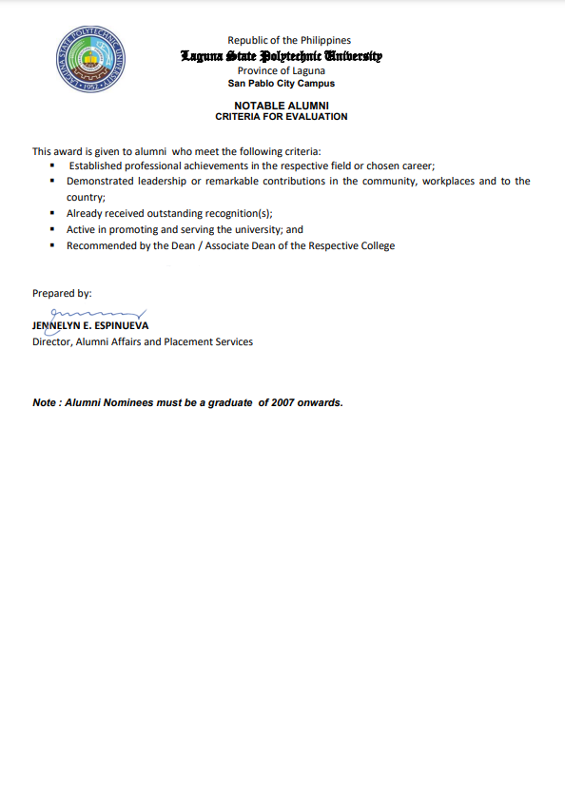
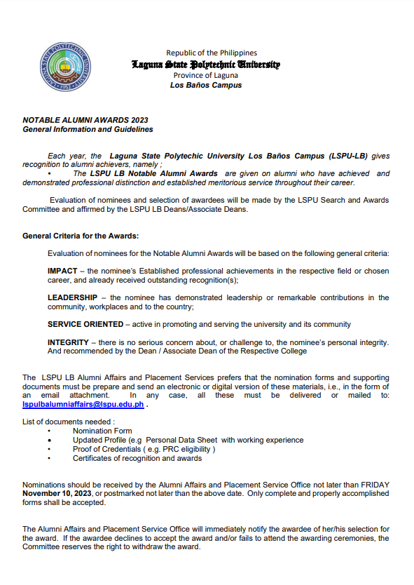
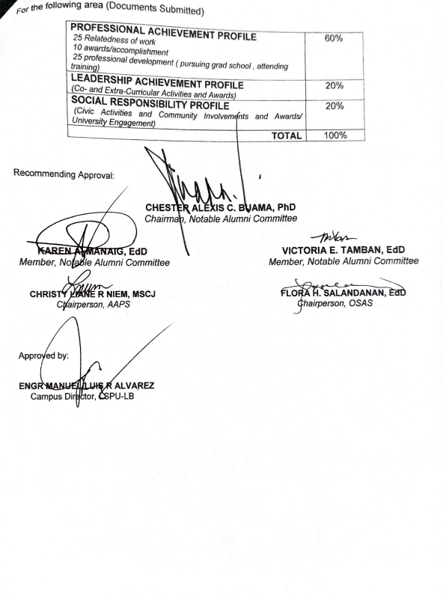
Criteria for notable alumni
Notes:
This is the criteria shared to us, where the LSPU notable alumni merit points will be based on.

Slide 10
General Objective
Specific Objectives
To develop a generalized alumni management system with an implementation of data analytics for graph reports that will cater to university's requirements in accreditation that will be tested on Laguna Polytechnic State University - Los Baños Campus.
To develop a sustainable, and centralized alumni system for LSPU Los Baños Campus.
To provide a merit and criteria-based prescription module for selecting notable alumni.
To increase alumni respondents and data analytics reports.
To provide progress reports of alumni work experience for administration’s visual reports.
Notes:
Now onto the objectives. Our general objective is to develop a generalized alumni management system with the data analytics, and visualization features that will cater to the university’s requirements for accreditation. This project will be tested on the LSPU Los Banos grounds.
While our specific objectives is to develop a sustainable and centralized alumni management system for LSPU Los Banos. Second, to provide a merit and criteria-based prescription module for selecting notable alumni. Third, is to increase the alumni respondents and data analytics reports, and lastly, to provide progress reports of alumni work experience for administrator’s visual reports.

Slide 11

Project Purpose
The purpose of this project is to develop a sustainable alumni system that can be used easily by the alumni administration with an implementation of data analytics and visualization, and a prescription module for the assistance on selecting notable alumni. It is important for the developers to build a system that contributes to the Sustainable Development Goals (SDGs), also known as the Global Goals. SDGs were adopted by the United Nations in 2015 as a universal call to action to end poverty, protect the planet, and ensure that by 2030 all people enjoy peace and prosperity.
Notes:
For the project purpose is to develop a sustainable alumni system that can be used easily by the alumni administration. This project wishes to contribute to the Sustainable Development Goals.

Slide 12

Project Purpose
This addresses the SDG of Quality Education for an effective alumni management system can enhance education quality through improved communication between alumni and the university, thus also granting the institution to connect with them for seminars and/or workshops.
Notes:
Starting with Goal #4, Quality Education. In what way? Alumni who work for years in their industry can be considered as a professional in their field which they can bring and share this knowledge to students. Administrators can contact this people and organize a seminar or workshop or even mentorships.

Slide 13

Project Purpose
It also aimed to contribute to the SDG of Decent Work and Economic Growth by connecting alumni to employment opportunities as well as career development resources. Furthermore, data analytics can aid in identifying trends by collecting and analyzing data on alumni employment, including job placements, salary levels, and career advancement, universities can identify areas for improvement in their programs to better prepare students for the workforce
Notes:
This also aimed to contribute to Goal #8. The system will also provide a job board for the alumni who are still unemployed. This will be managed by the administrator.

Slide 14

Project Purpose
This aligns with the SDG of Industry, Innovation, and Infrastructure due to the goal for a sustainable and centralized system with data analytics and visualization features that assist and generate reports according to the data collected by the administrators. In the long run, when the system is sustained, it will require a data warehouse for big data.
Notes:
This also contributes to Goal #9, due to the goal of a sustainable and centralized system, this could improve the productivity within the admin. In the long run, bigger data means it needed a data warehouse

Slide 15

Project Purpose
This can also address the SDG of Reduced Inequalities by facilitating connections between alumni from backgrounds and providing support to underrepresented groups, and also addresses the prescription module, with the help of data analytics, to be used on the selection process of the notable alumni based on the criteria for the achievements and contributions of the individual thus mitigating the biases and systematic inequalities.
Notes:
Lastly, this also addresses the Goal #10, with the prescription module, it will prevent or reduce biases in the selection process of the notable alumni award enforcing fairness.

Slide 16
Scope of the project
Limitations
Content Management
This part of the project focuses on organizing and overseeing the content within the alumni management system. This includes managing alumni profiles, event details, news updates, and job listings. The goal is to create a user platform for both alumni and the institution to access and exchange information efficiently.
Utilizing Data Analysis and Visualization
This section involves using data analysis methods to study alumni data and give insights by creating representations like charts, graphs and dashboards to present these findings in a clear and understandable manner.
Notable Alumni Merit System
This module aims to identify and highlight notable alumni through a module based on their achievements and contributions. By using data analytics to assess alumni profiles, the system recognizes individuals who have made significant impacts. The Prescription Module suggests actions such as featuring alumni in promotions, inviting them as speakers, or arranging mentorships.
Data Quality Issues
The accuracy, completeness, and consistency of information about alumni can be different causing some difficulties in data analysis and visualization. The existence of weak points such as the presence of missing or incorrect records, duplications and historical updates may challenge the effectiveness of findings yielded by the product.
User Adoption
Alumni and institutional administrators’ active involvement is essential for successful system implementation. Devising plans to improve user’s perception and to persuade them into using it.
Notes:
The scope of the project and the limitations. Starting off with the content management, administrators oversee the content where users will browse. This is where the news and events, and job board can be found. Second, utilizing data analysis and visualization, this is for the administrator’s side where they can study the data and generate the reports via graphs and charts. Lastly, the notable alumni merit system, where the prescription module will contribute in the selection process of the notable alumni.
As for the limitations of the project, data quality issues where data depends on the accuracy, and completeness of the information about the alumni. This could greatly affect the generation of reports. Lastly, user adoption, where it requires for the system to have an active involvement from the users, more specifically the administrators.

Slide 17
Conceptual framework
Notes:
This is our conceptual framework, where the features of the system that can accessed by both the admin and users. However, the management responsibilities lies with the administrators.

Slide 18
Project Design

Slide 19
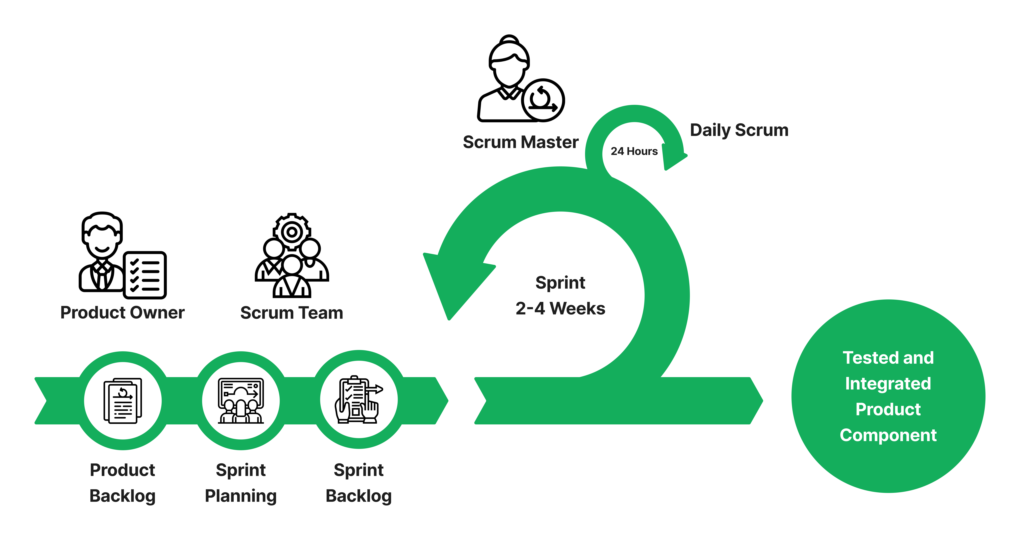
Project Development
Agile Scrum Diagram

Slide 20
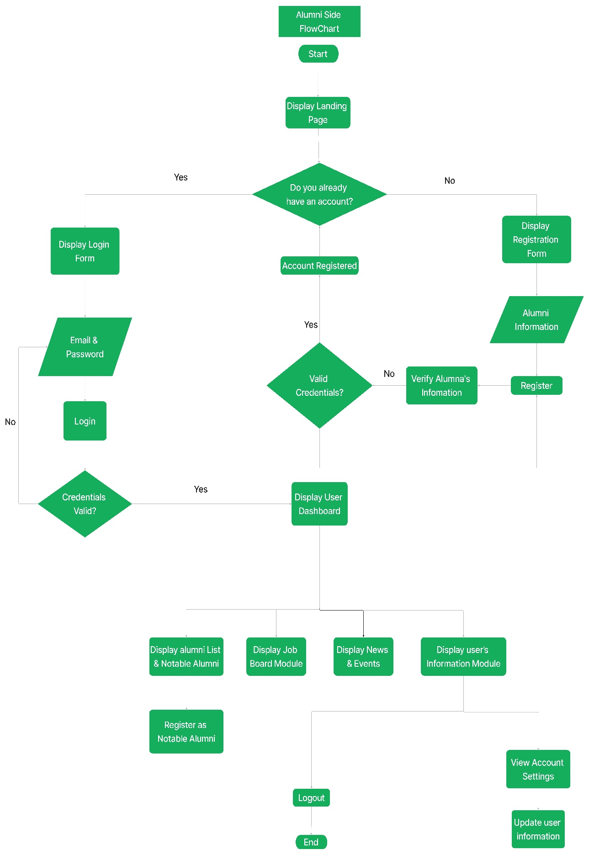
Alumni Management System Flowchart for User’s Side

Slide 21
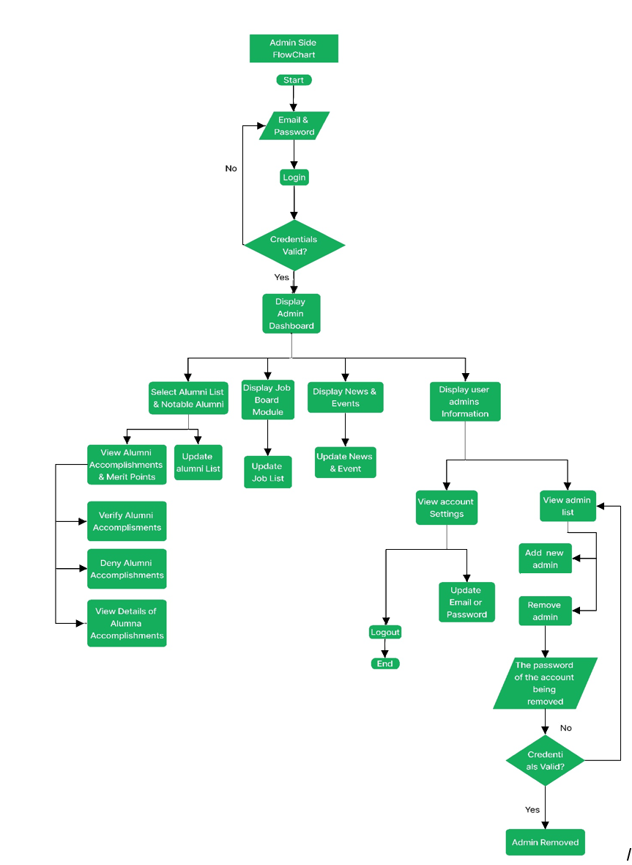
Alumni Management System Flowchart for Administrator’s Side

Slide 22
Use case diagram of the alumni management system

Slide 23
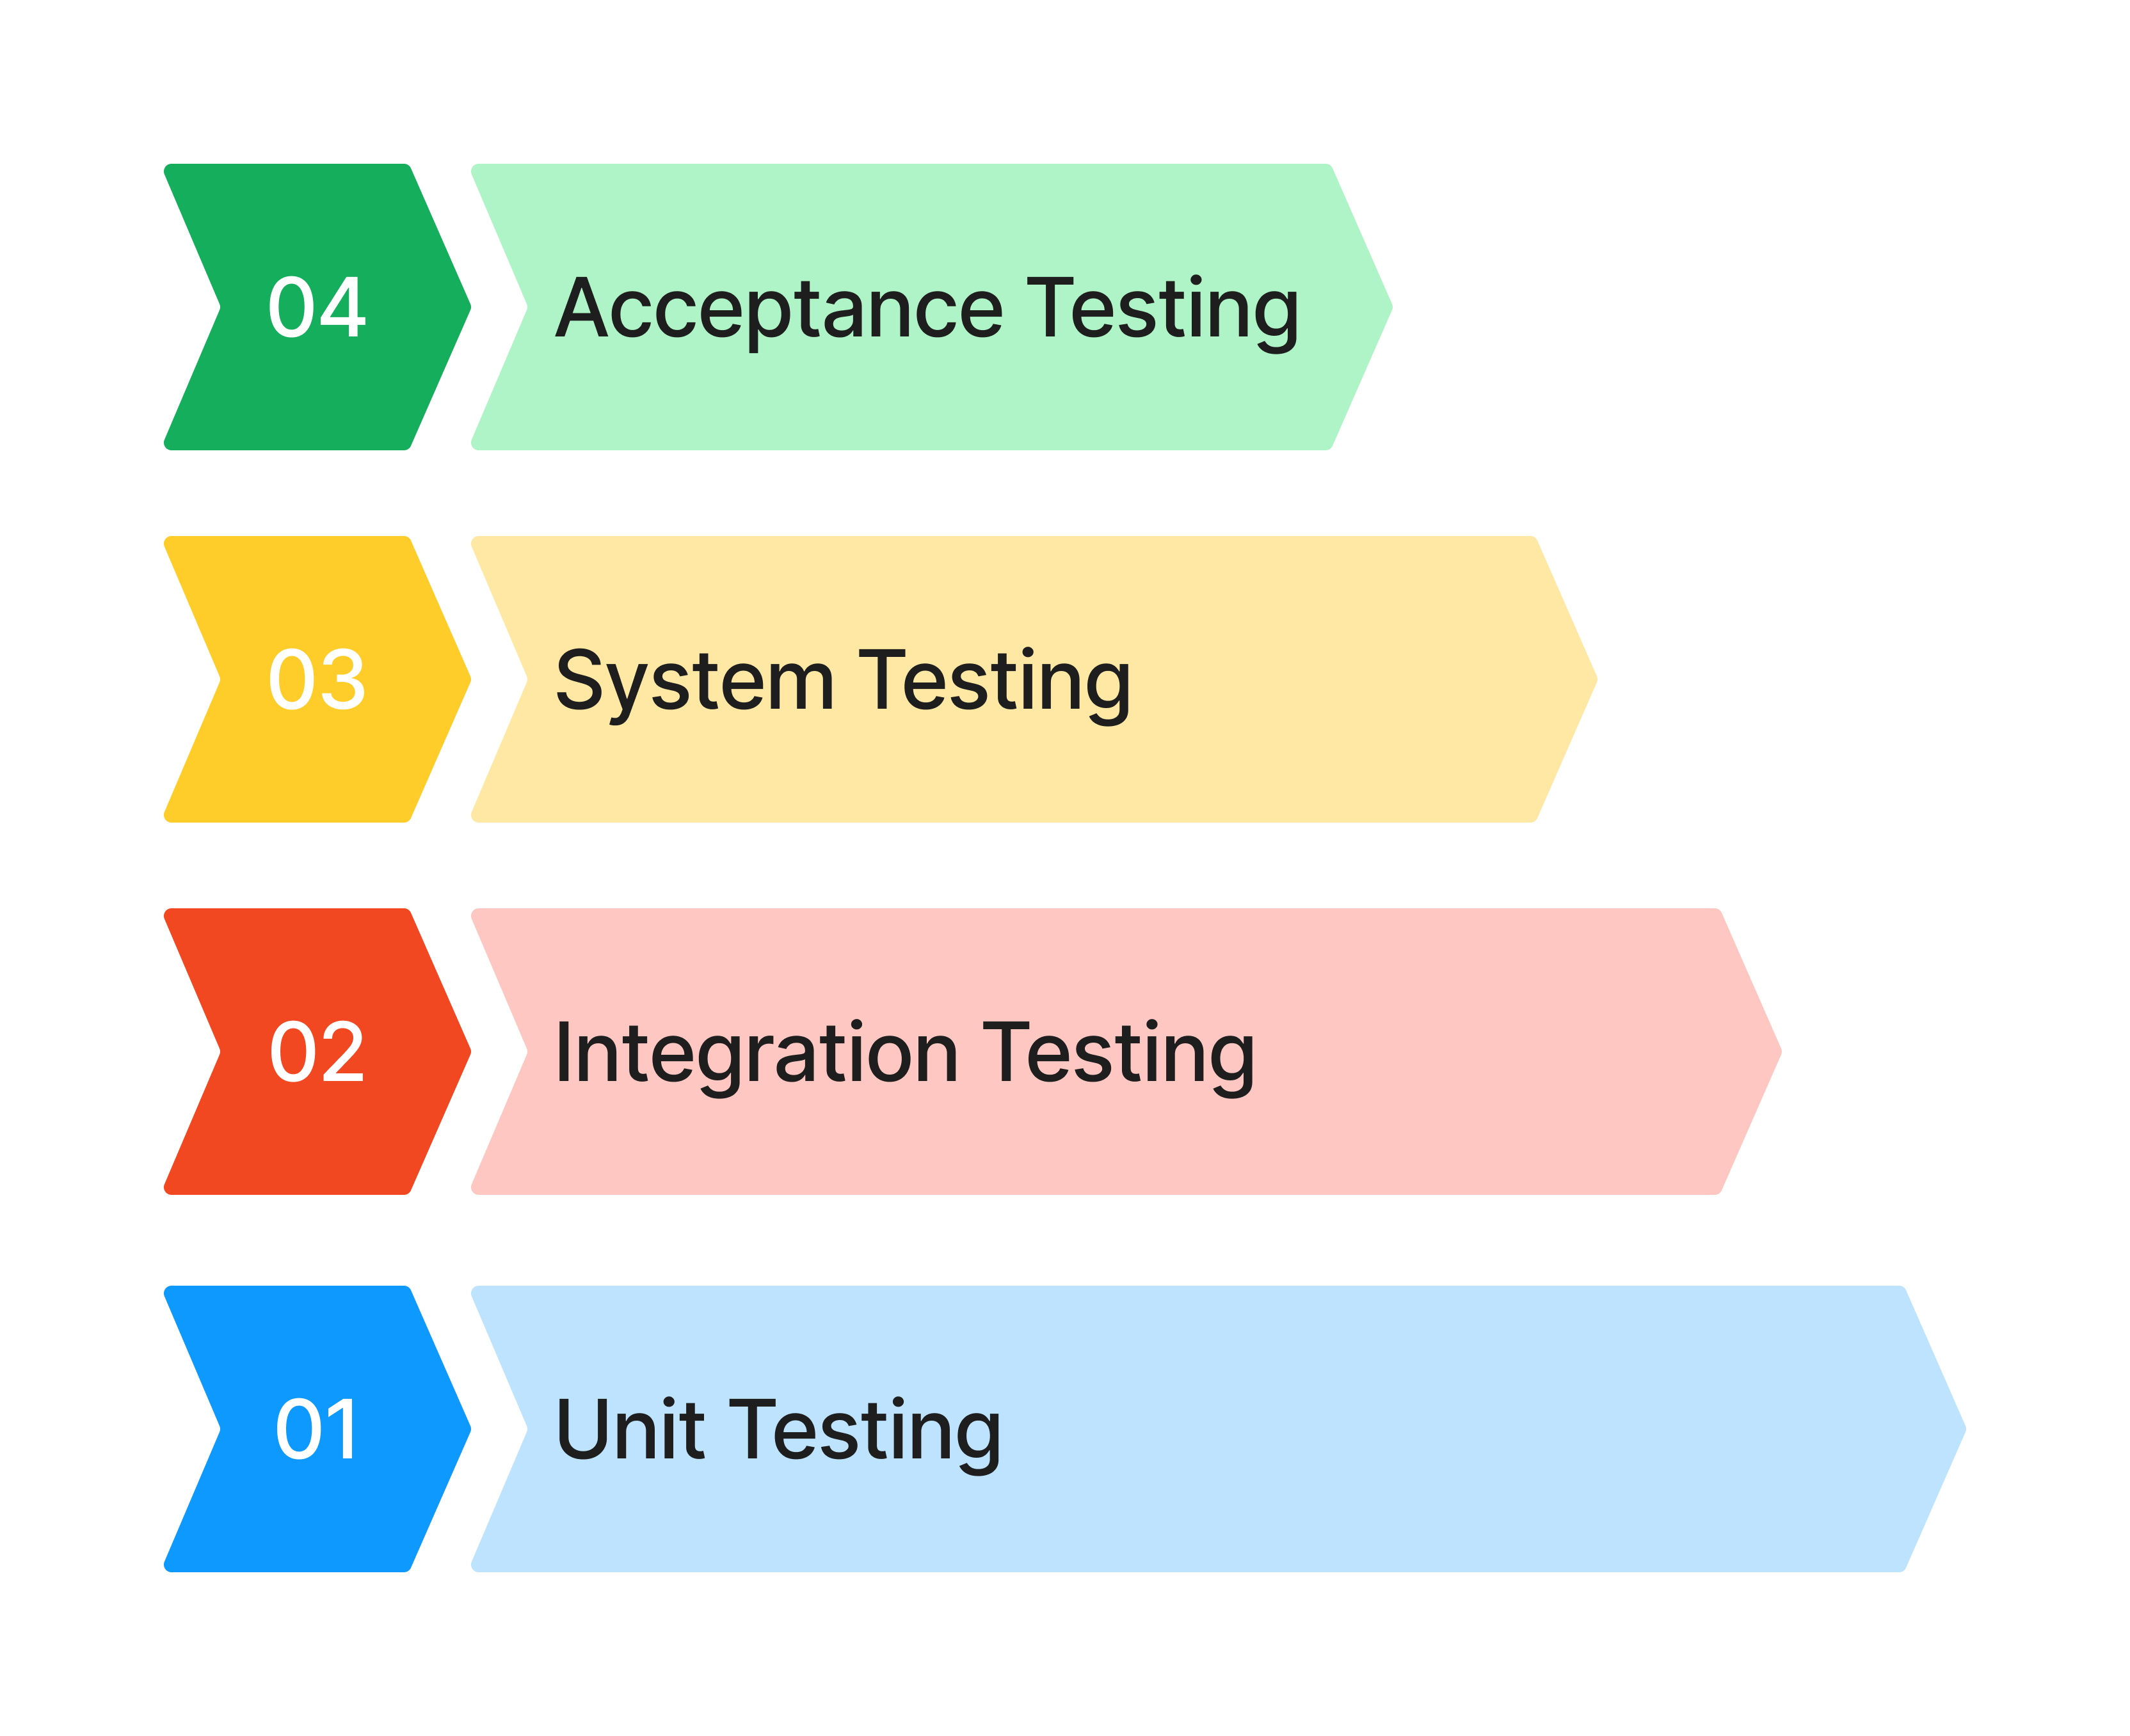
Project Testing and Evaluation
Levels of Software Testing

Slide 24
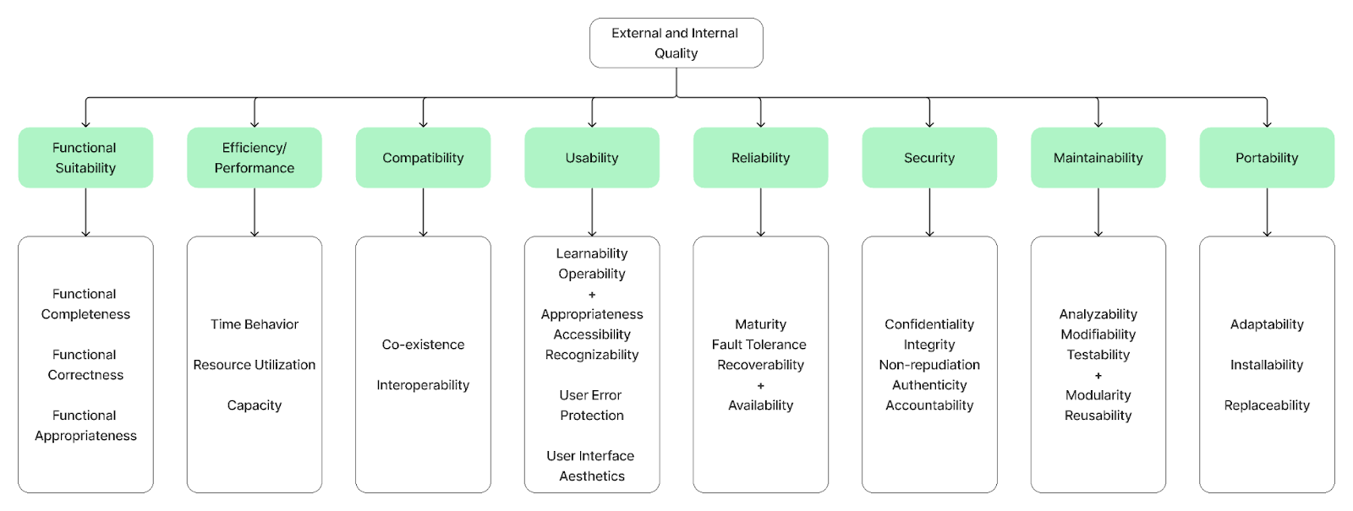
Evaluation procedure
ISO 25010
Categorization of Software Quality

Slide 25
Population of the study
CATEGORY OF RESPONDENTS | SAMPLE
Alumni (Users) | 94
House of Alumni Administrators | 4
IT Experts | 2
Total | 100
The target users are alumni of CCS since they are one of the premises for pilot testing the system, while the administrators will scrutinize the features and modules of the system. The developers will also include IT Experts for inquiry and testing regarding the environment and functionalities of the system.

